Slide 1





FOREST COVER DATA TYPE PREDICTION
Capstone Proect
by Swathi.S

Slide 2
Project Title & Overview
  Problem Statement: The objective of this project is to predict the type of forest cover based on cartographic variables such as elevation, aspect, slope, soil type, and wilderness area
  Dataset Overview: 581,012 samples, 12 original features (cartographic and soil types, wilderness areas).
  Core Goals: Build an efficient classification model that accurately identifies the forest cover type from the provided geographical and environmental features.

Slide 3
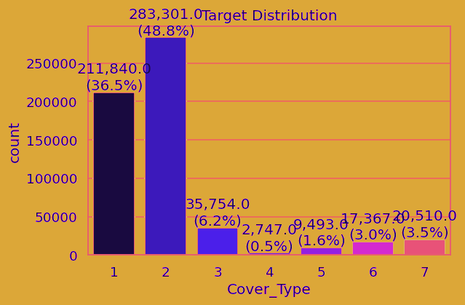
Exploratory Data Analysis (EDA) & Data Insights
  Severe Class Imbalance: Cover Types 1 (Spruce/Fir) and 2 (Lodgepole Pine) make up ~85% of the data, while Type 4 (Cottonwood/Willow) makes up only 0.5%.
  Key Feature Distributions: Elevation emerges as the single most predictive feature, showing clear separation between different cover types.
  Multicollinearity: Note high correlations between Hillshade variables and between Hydrology distances.

Slide 4
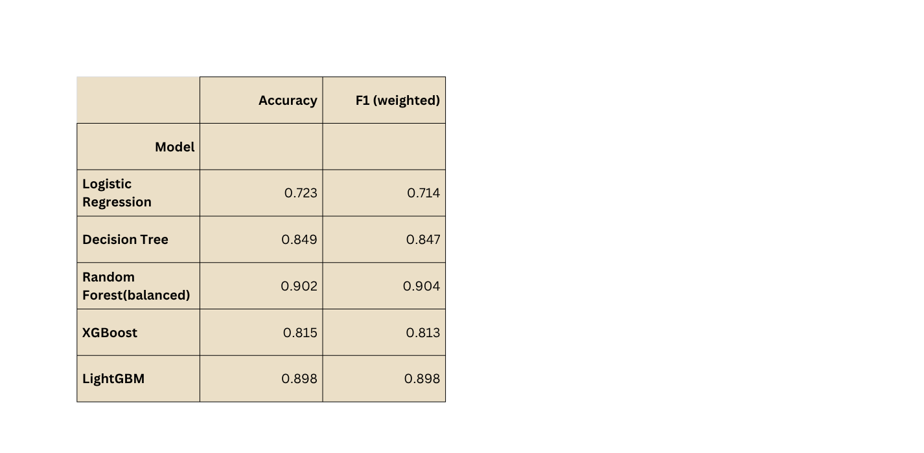
Preprocessing & Baseline Model Benchmarking
  Preprocessing Pipeline: Standard scaling of numerical columns, zero-indexing targets for gradient boosters.
  Baseline Algorithms: Evaluated Logistic Regression, Decision Tree, Random Forest (Balanced), XGBoost, LightGBM, and an Artificial Neural Network (PyTorch).
  Performance Highlights: Random Forest (Balanced)outperformed all other baselines with F1-scores of ~0.90.

Slide 5
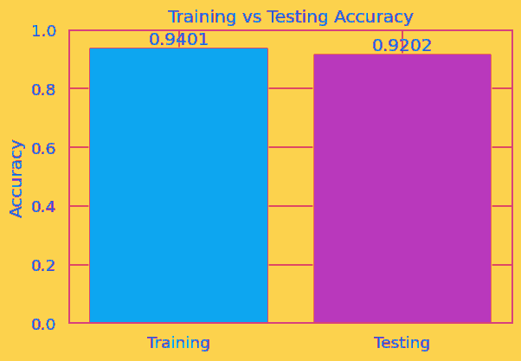
Hyperparameter Tuning & Final Model Selection
Tuning Strategy: Randomized Search CV conducted on 25% subset of data to optimize the Balanced Random Forest Classifier.
Best Parameters: n_estimators: 500, max_depth: 40, min_samples_split: 2, min_samples_leaf: 1.
Final Test Performance: Achieved 92.02% Test Accuracy and 0.92 Weighted F1-Score when scaled back to the full dataset.

Slide 6
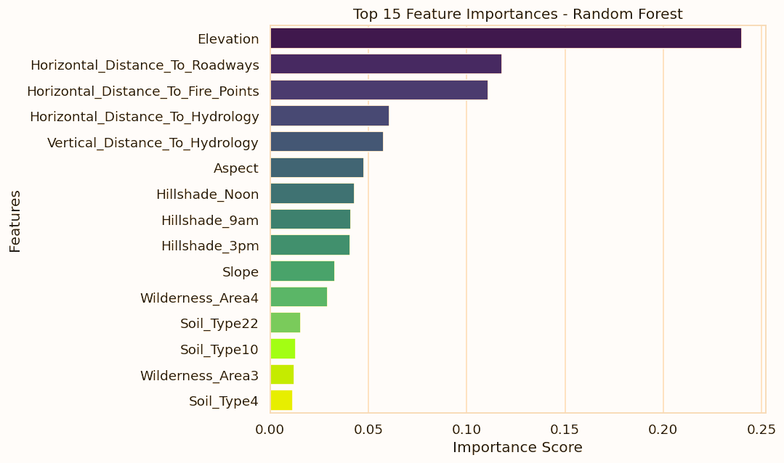
Feature Importance & Ecological Insights
  Top Predictors: Elevation (24.0% importance), followed by Horizontal Distance to Roadways (11.8%) and Fire Points (11.1%).
  Ecological Significance: Tree species survival is heavily stratified by altitude (elevation) and proximity to water and roadways (disturbances/microclimates).
  Business/Operational Value: Enables automated, highly accurate GIS-based forest mapping, reducing the need for costly physical surveys.

Slide 7
Thank you

